Slide 1
Decision Analysis Examples
Fish 558; Day 3: 08h30-10h00

Slide 2
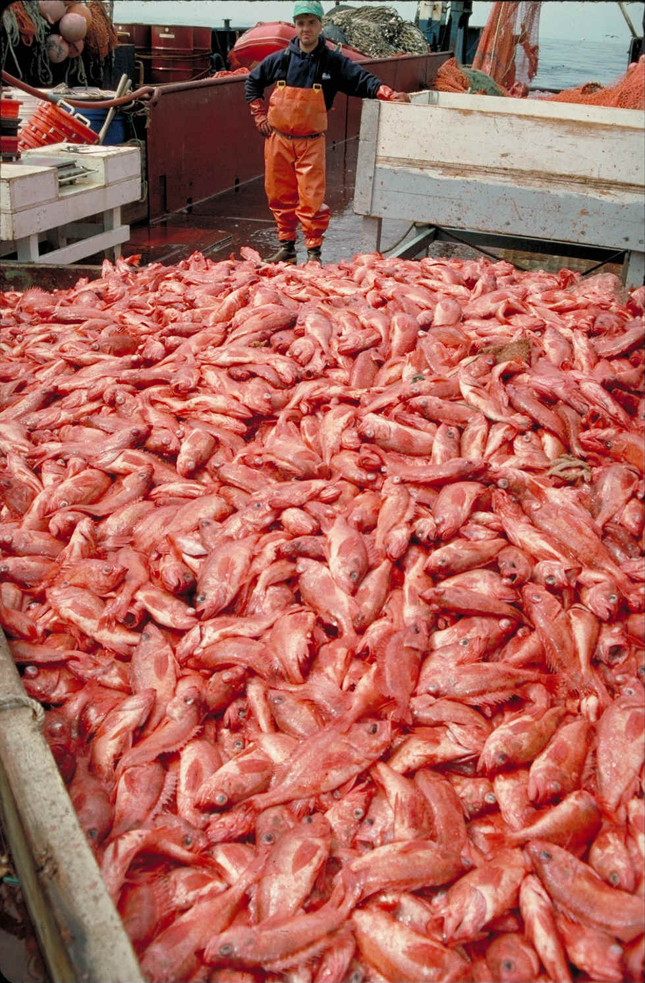
Pacific Ocean Perch, Sebastes alutus
off Washington and Oregon
Chief Source:
Hamel, O.S. 2005: Status and Future
Prospects for the Pacific Ocean Perch
Resource in Waters off Washington and
Oregon as Assessed in 2005.

Slide 3
Brief History
The fishery started in ~1956
Large removals (5~20,000t) occurred during the mid-1960s (primarily foreign vessels).
The foreign fishery ended in 1977.
Catches have been moderate-to-low since 1969.
The species has been under a formal rebuilding plan since 1981.
The rebuilding plan was modified in 1999 to conform with the National Standard 1 Guidelines of the Magnusson-Stevens Act.

Slide 4
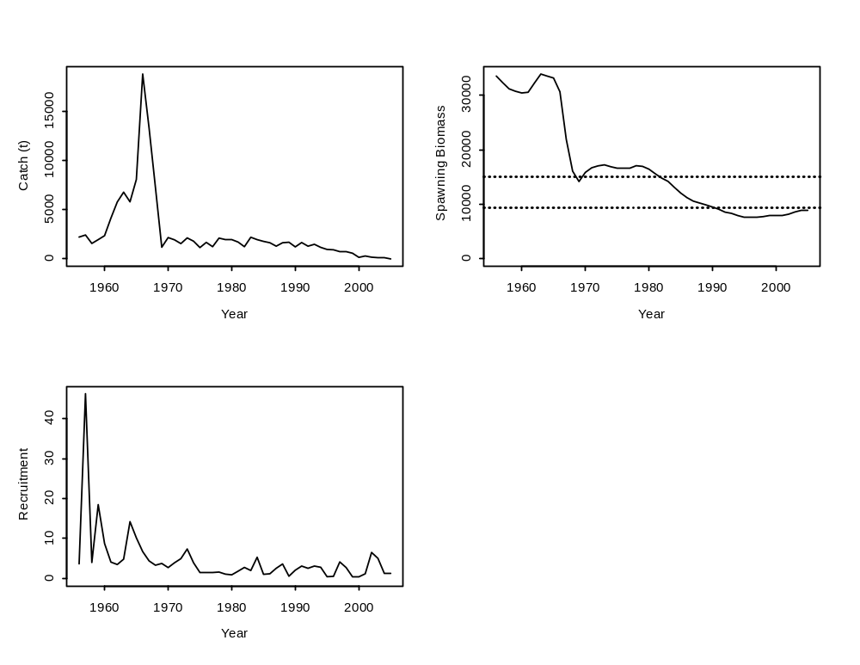
Overview of Current Status
Target level
Overfished level

Slide 5
Risk Analysis-Overview
Management objective: Recover to the target biomass (40% of the unfished spawning biomass, 0.4B₀) with 50% probability by 2027 (a 70% probability of recovery to 0.4B₀ by 2042).
Management actions: F=0.01; F=0.02 after catches of 447t for 2005 and 2006.
States of nature: Percentiles of the posterior for the depletion of the spawning biomass at the start of 2005.

Slide 6
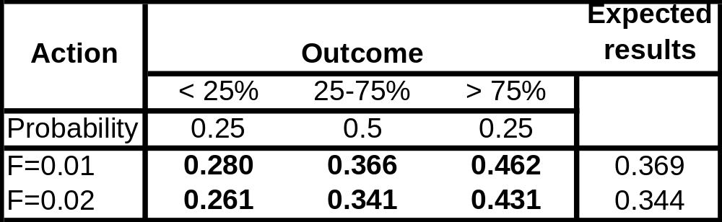
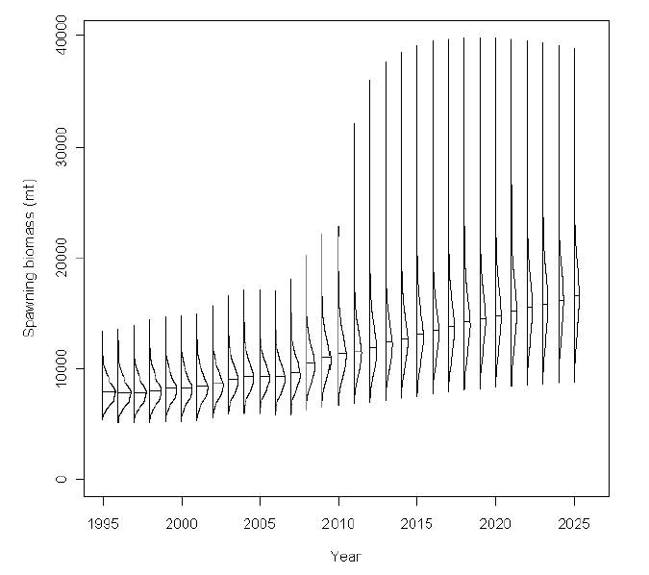
Risk Analysis-Decision table

Slide 7
Technical Details -I
The population dynamics model:
  age-structured;
  Beverton-Holt stock-recruitment relationship;
  process error in recruitment; and
  single fleet with time-varying selectivity.
The (informative) priors:
  natural mortality; and
  the steepness of the stock-recruitment relationship.

Slide 8
Technical Details -II
The data used for parameter estimation:
  catch-at-age data (surface and break-and-burn ages);
  catch-at-length data (for the years for which age-composition data are not available);
  historical catch-rates; and
  survey indices of abundance.

Slide 9
Treatment of Uncertainty
Process error: future recruitment variation only.
Observation uncertainty: accounted for when developing the posterior distribution.
Model uncertainty: none, but:
  this stock is probably shared with Canada; and
  the extent of recruitment variation and the growth curve are assumed known.
Implementation uncertainty: none, but uncertainty related to discarding (and the impact of fishing in Canada) are perhaps sources worth considering.

Slide 10
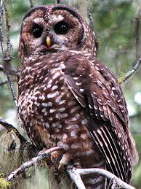
Spotted Owls
Sources:
Doak, D. 1989. Spotted owls and old growth
logging in the Pacific Northwest.
Conservation Biology 3: 389-396.
Lahaye, W.S., Gutierrez, R.J. and H.R. Akcakaya.
1995. Spotted owl metapopulation dynamics
in Southern California. Journal of Animal Ecology
63: 775-785.
www.abcbirds.org

Slide 11
Background-I
The spotted owl (Strix occidentalis) is found in forest mountains of western North America from central Mexico to southern B.C.
Three subspecies:
  Northern sub-species (S. occidentalis caurina);
  Mexican sub-species (S. occidentalis lucida); and
  California sub-species (S. occidentalis occidentalis).

Slide 12
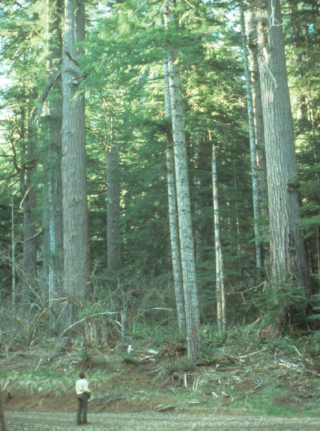
Background -II
Closely associated with late seral stage and primary forests.
Some populations have been declining (Mexican and Northern sub-species are ESA listed).
Most females breed at age 3, but some appear to breed as age 2.
Fledglings disperse, but the probablity of dispersal mortality is high ~ 80%.

Slide 13
Background-III
Aims of the modeling:
  What is the probability of continued decline in population size / extinction?
  What parameters / processes have the largest influences on the probability of continued decline in population size / extinction?

Slide 14
Model Outline-I
Female-only
Spatially-explicit:
  Dispersal between and within “clusters” of territories:
    a “cluster” is a set of territories that are all equally accessible to each other, but are less accessible to territories in other clusters.
  The probability of successful dispersal depends on whether dispersal is to the cluster of birth or to another cluster.
Number of territories (750, 1500, 3000) and territories per cluster (3, 10) are specified.

Slide 15

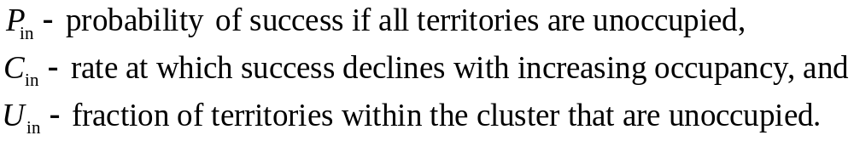


Model Outline-II
The probability of dispersing within a cluster is:
 | 0.815, 1.086
 | 2

Slide 16
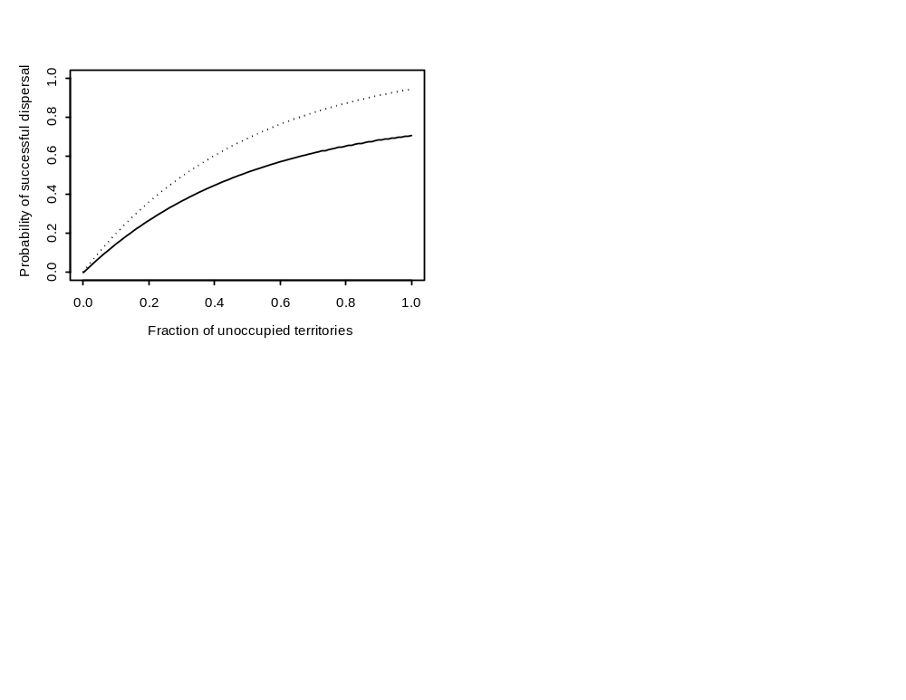
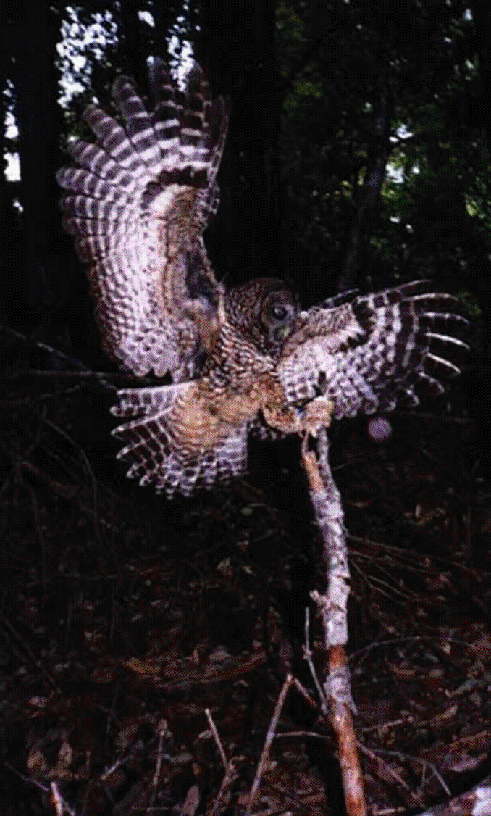
Model Outline-III

Slide 17

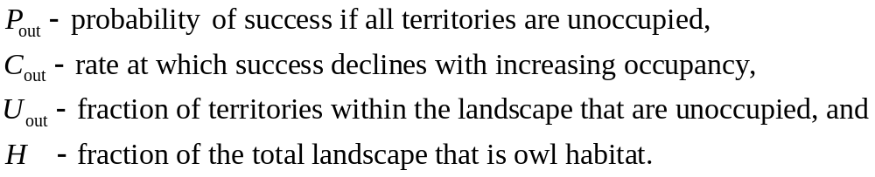


Model Outline-IV
The probability of dispersing to another a cluster is:
 | 0.30, 0.40, 0.60
 | 5, 10
H | 0.108, 0.216, 0.432

Slide 18
Model Outline V
Demographics:
  Each territory can hold one and only one female.
  Survival is age-specific (and, for age 0, depends on dispersal).
  Demographic uncertainty in the probability of death and birth.
  Environmental stochasticity in the probability of birth (a beta distribution with mean 0.25).

Slide 19
Parameter Values
Parameter | Value
s₀ fledgling survival probability | 0.60
s_{d} probability of successful dispersal | 0.18
s₁ subadult annual survival probability | 0.71
s adult annual survival probability | 0.942
b annual female average fecundity (in females) | 0.24
age at first breeding | 2
H current percentage of landscape suitable for owls | 0.38
I-U current fraction of suitable territories that are occupied | 0.44

Slide 20
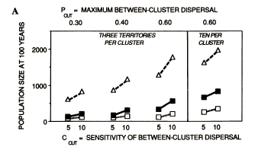
Typical Results
Mean population size after 100 years with three or ten territories per cluster.
Δ - 3,000 territories; - 1,500 territories; □ - 750 territories.

Slide 21
Overall Evaluation
Model uncertainty:
  None.
  Model is not really spatially-explicit (all clusters are equally “reachable”)
Uncertainties considered:
  Future demographic stochastcity (how important is this).
  Future environmental stochastcity.
Utility for a Decision Analysis:
  No probabilities attached to alternative hypotheses.
  No alternative management actions (except “no action”).

Slide 22
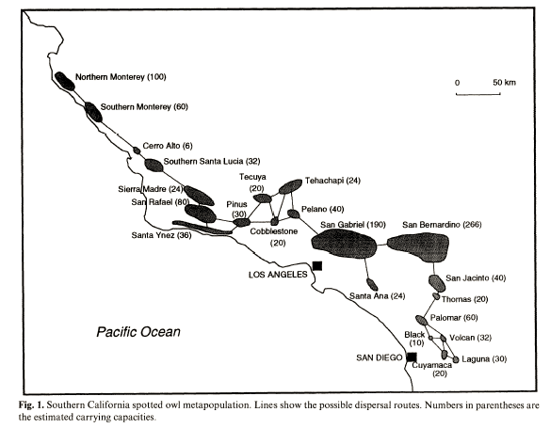
Allowing for Metapopulation Structure Explicitly

Slide 23
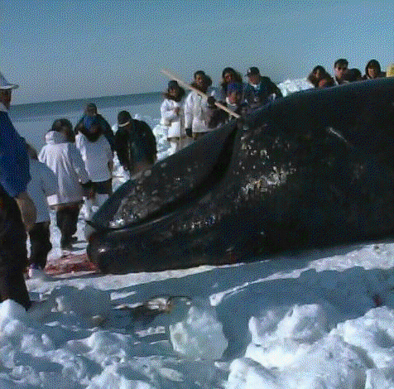
Bering-Chukchi-Beaufort Seas
bowhead whales
Source:
Brandon, J.R. and P.R. Wade. A stock
assessment of the Bering-Chukchi-Beaufort
Seas stock of bowhead whales using
Bayesian model averaging. Journal of Cetacean Research and Management.

Slide 24
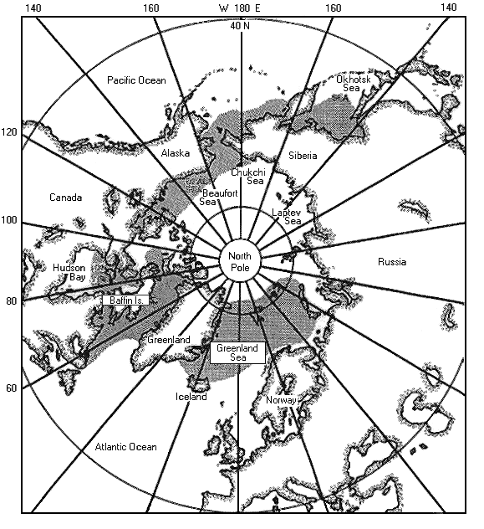
Distribution and Biology
Five stocks are recognized:
Spitzbergen
Hudson Bay
Davis Strait
Okhotsk Sea
Bering-Chukchi-Beaufort
Bowhead whales are among the
longest-lived of the great whales
and have been aged to over 100
years.

Slide 25
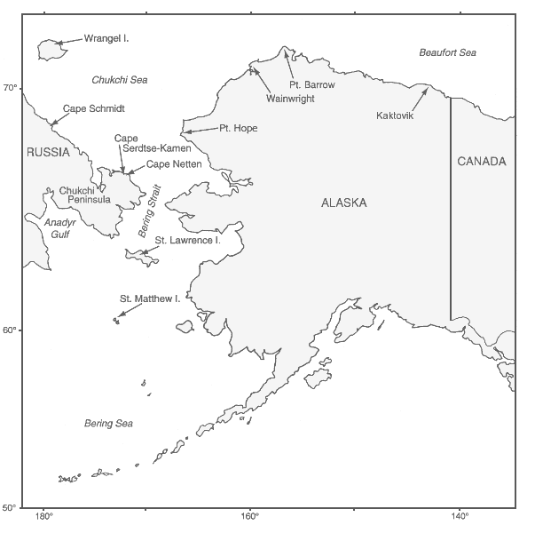
The B-C-B Bowhead Stock
The Bering-Chukchi-Beaufort (BCB) stock is the largest and has been monitored the most intensively.
Bowheads are harvested at several villages in Alaska and Russia during spring and fall migrations from winter feeding grounds (the Bering Sea) to summer feeding grounds.
Calving occurs in fall (before and during the fall migration).
Migrations to and from the feeding grounds are segregated by sex and life-stage.
The migration past Barrow provides an ideal opportunity to monitor this population.

Slide 26
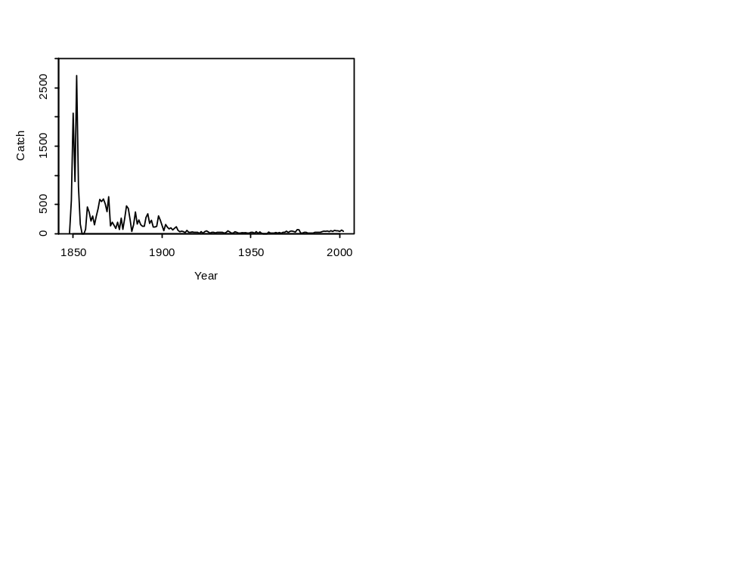
The Fishery
The stock has been subject to both commercial and aboriginal harvest.
The commercial fishery occurred between 1848 and 1914.
Aboriginal harvests have occurred throughout history and have been the primary source of removals since 1914.
The allowable catch of BCB bowheads is decided by the International Whaling Commission (IWC) taking account of the needs of aboriginal communities and the risk to the recovery of the population.

Slide 27
Aims of the Modeling
Estimate the current (2002) total population size.
Estimate the current replacement yield (the catch in 2002 that will leave the total population size at the start of 2003 equal to that at the start of 2002)

Slide 28
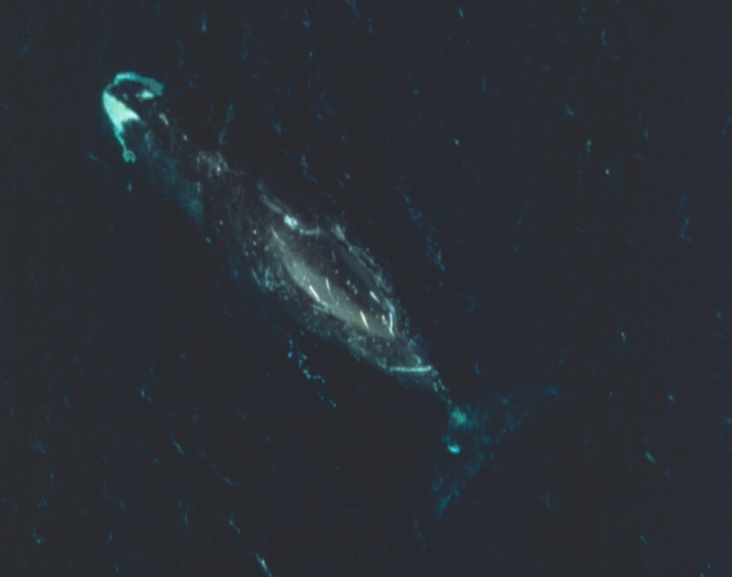
Data Available
Catches (assumed 50:50 males: females).
Survey estimates of abundance with coefficients of variation and between-year correlations (1978, 1980, 1981, 1982, 1983, 1985, 1986, 1987, 1988, 1993, 2001) (Zeh and Punt, 2005).
Proportion of the population during 1985-94 consisting of calves and mature animals.

Slide 29
Models
Basic structure:
  age- and sex-structured model;
  50:50 sex-ratio at birth;
  different calf, juvenile, and adult survival rates;
  all animals aged 1 and older are equally vulnerable to harvest; and
  density-dependence on calf survival (if density-dependence is included in the model).
Alternative models:
  Density-dependent – start at pre-exploitation equilibrium in 1848 (1848 DD).
  Density-dependent – start with an equilibrium age-structure in 1978 (1978 DD).
  Density-independent - start with an equilibrium age-structure in 1978 (1978 NON DD).

Slide 30
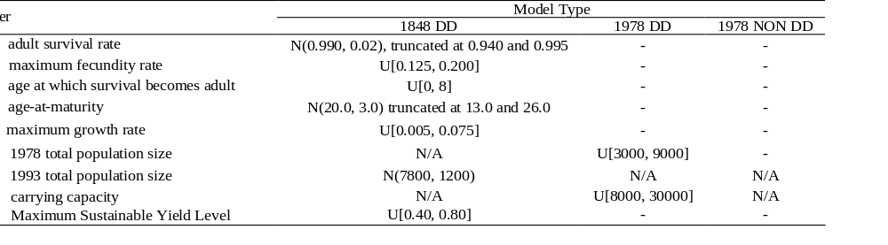
Parameter Estimation
Bayesian with priors:
The Bayesian calculations are based on the SIR algorithm.
We will discuss this algorithm later.

Slide 31
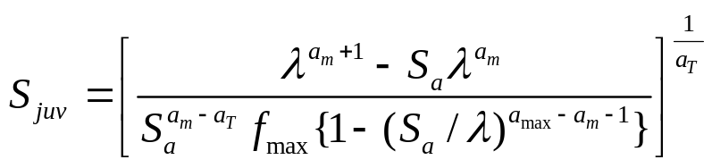
Technical Issues - I
The juvenile survival rate, S_{juv}, is not an estimated parameter,
but is rather calculated using the equation:
where λ is r_{max}+1

Slide 32
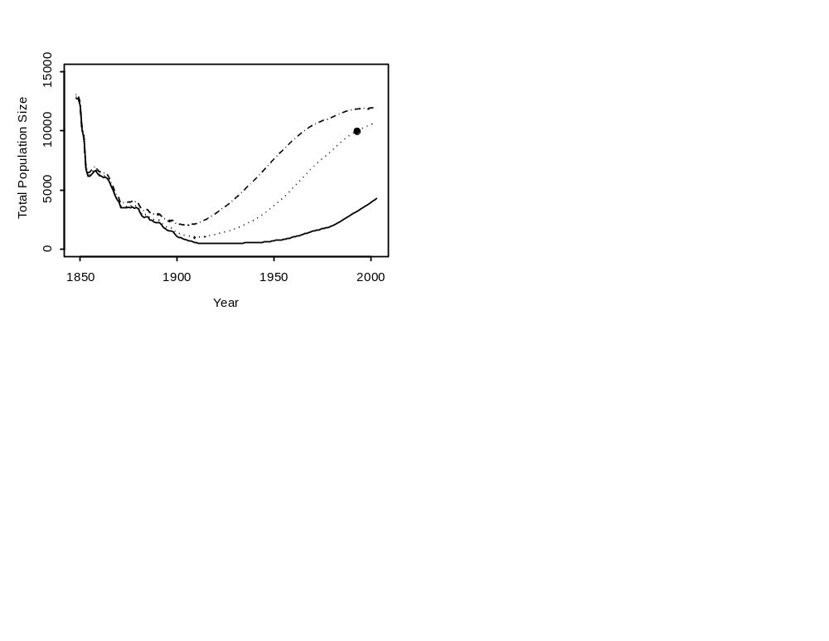

Technical Issues - II
K is not an estimated parameter of the model when the population
projections start in 1848. Rather the value of K is chosen that if the
population is projected from 1848 to 1993, the population size in 1993
equals :

Slide 33
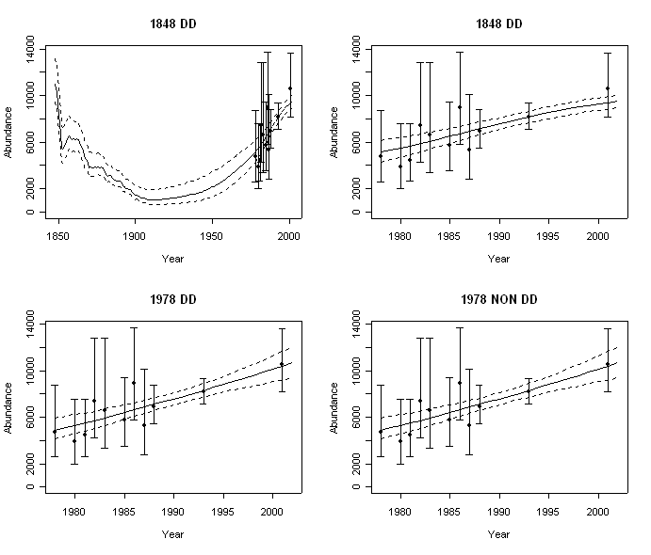
Results-I
(Fits to the Data)

Slide 34
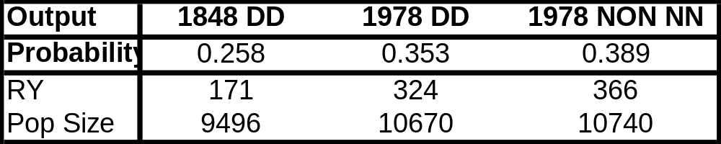
Results-II
(Summary)

Slide 35
Overall Evaluation-I
Model uncertainty:
  Alternative formulations for density-dependence.
  Alternative models for stock structure were considered but ultimately not found to be useful.
Uncertainties considered:
  Uncertainty implied by the fit of the model to the data.
  No demographic or environmental stochastcity (although this could be done).
Utility for a Decision Analysis:
  Probabilities assigned to models and parameter values within models.
  No alternative management actions ( although it would be straightforward to evaluate the consequences of alternative management actions).

Slide 36
Overall Evaluation-II
Positives:
  The original analysis (Raftery et al. 1995) provided an effective means of summarizing all of the available information for the BCB bowhead whale.
  This basic approach has been extended and applied to a variety of other baleen whale species.
Negatives:
  There has been considerable discussion regarding the choice of priors.
  The method is subject to the “Borel paradox”.

Slide 37
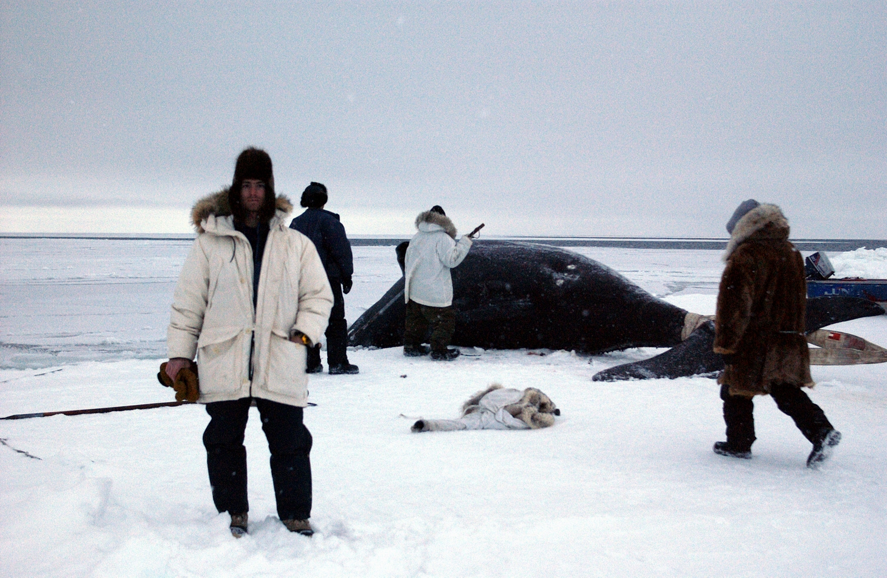
Getting to know the Data!
This is definitely not me!

